Slide 1
OpenCV with USB Camera and Pi Camera
Session 7

Slide 2
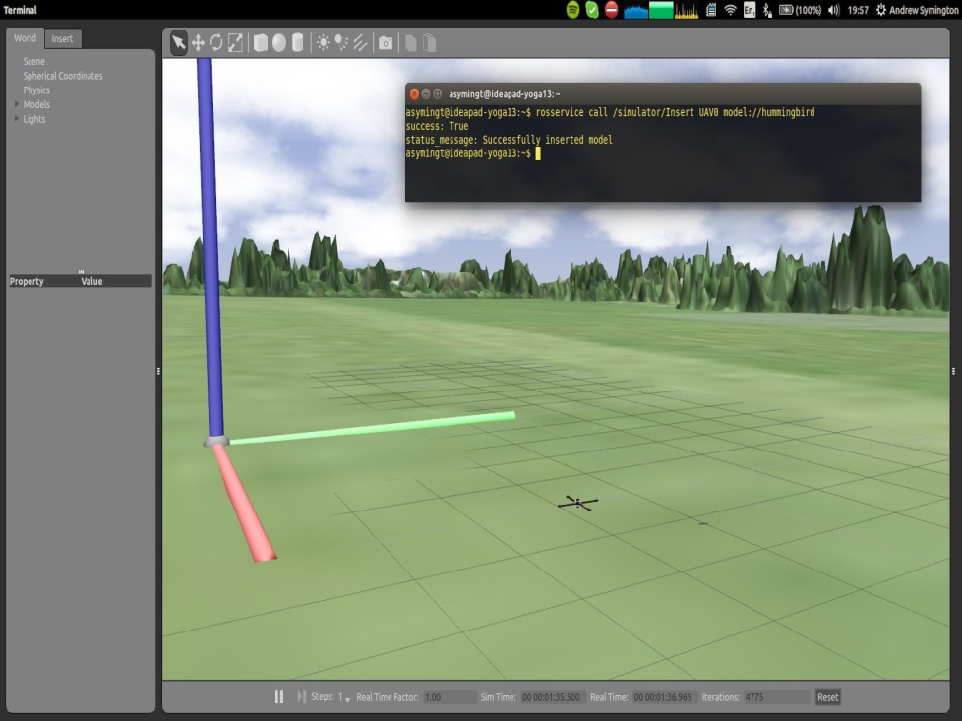
Robot Operating System (ROS)
Standardized package manager
Runs on Ubuntu
Standardizes message-protocols for:
Pose estimation
Localization
Navigation
Computer vision
Incorporates the latest contributions from academia
Andrew Symington, UCL Gazebo and rviz with several quadrotors, ROSCon 2014

Slide 3
Computer Vision Sounds Awesome… …But what is it?

Slide 4
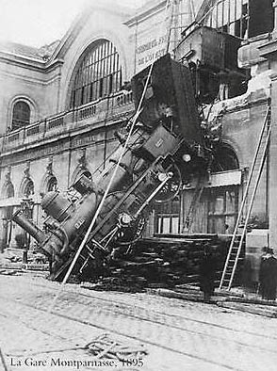
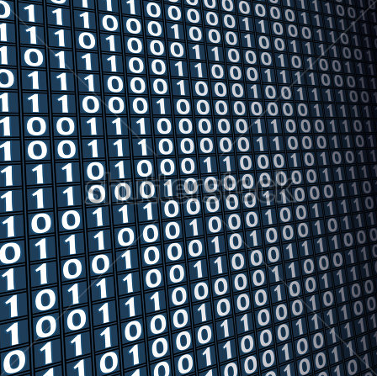
CV: Glad you asked.
Perception and interpretation of sensory signals
What we see
What a computer sees
Or simply: give meaning to images and videos
Notes:
Computer vision means perception and interpretation of sensory signals.
<click> Whereas we see lots of things here: a train, an accident,
<click> the computer only sees a string of numbers.
<click> The challenge is to tease out the meaning from these numbers that encode images and videos.
4

Slide 5
Challenge: Lighting Conditions
Graphics is hard, vision is harder slide
Notes:
The same scene, even from the same point of view, may look dramatically different under different lighting conditions.
5

Slide 6
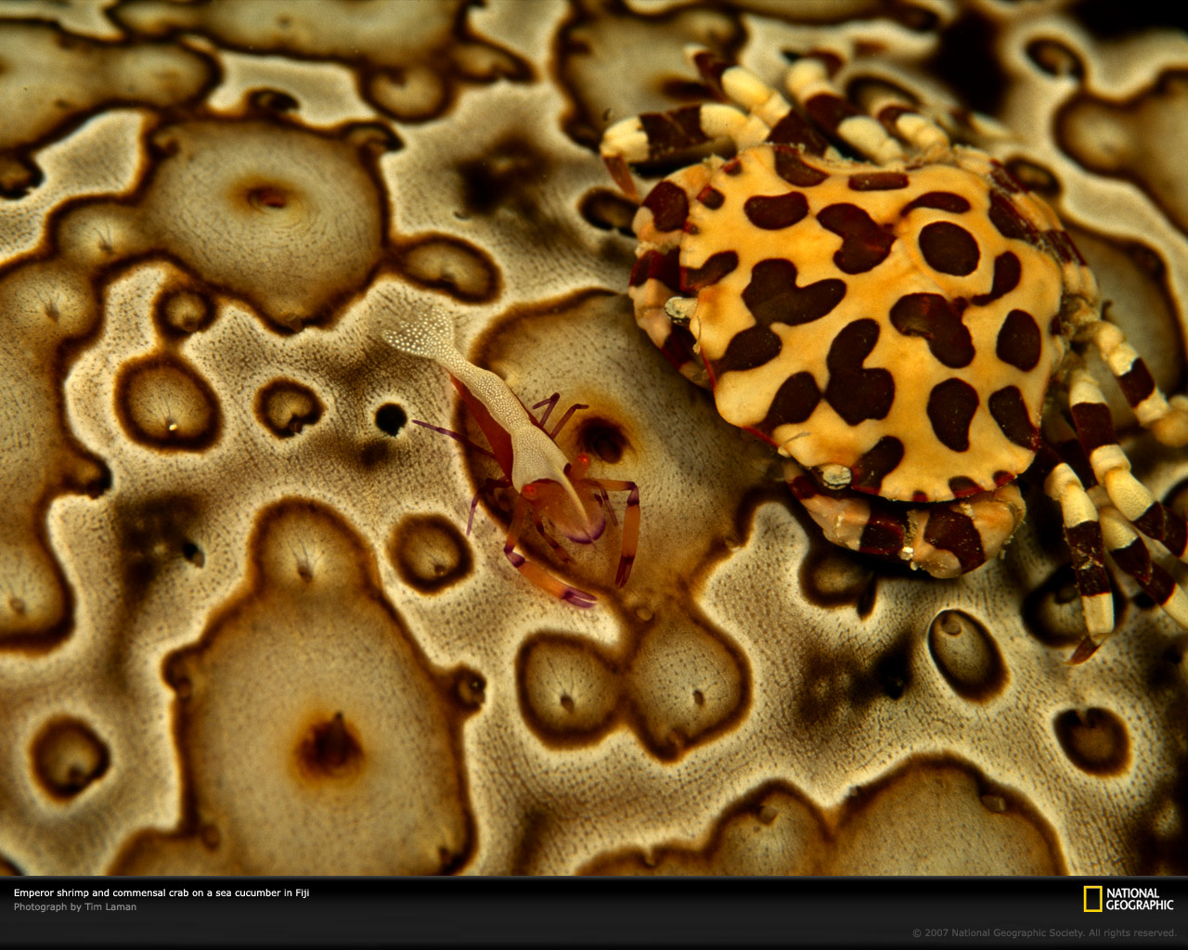
Challenge: Background Clutter
Notes:
It is often not even easy to separate what are the objects in the foreground,
in this case two crabs,
and what is the background surface on which they are located.
6

Slide 7
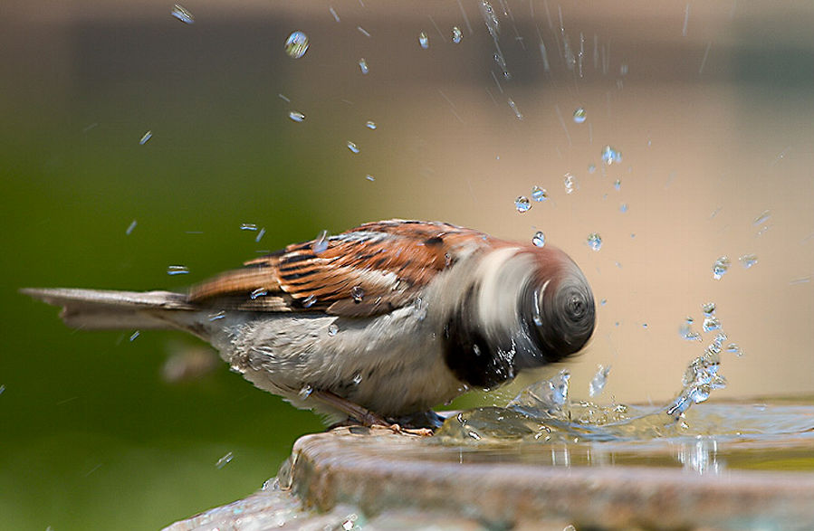
Challenge: Motion
Notes:
When objects move fast, they become blurred, and difficult to recognize.
7

Slide 8
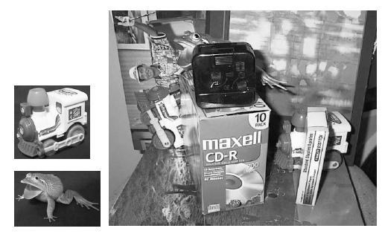
Challenge: Occlusion
Notes:
And often the objects remain partially hidden,
and are difficult to find among the clutter,
<click> like the toy frog,
<click> or the two train engines.
8

Slide 9
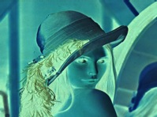

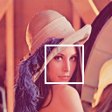
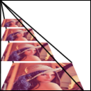
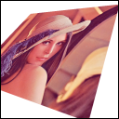
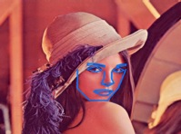
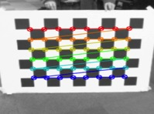
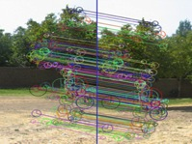

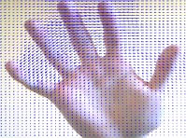
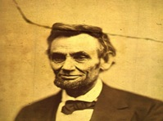
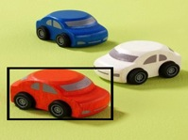
OpenCV Library
Initially developed by Intel for single-core x86 CPUs
OpenCV4Tegra — Accelerated CUDA+NEON+GLSL+TBB multithreading
Image processing
General Image Processing
Segmentation
Machine Learning, Detection
Image Pyramids
Transforms
Fitting
Video, Stereo, and 3D
Camera Calibration
Features
Depth Maps
Optical Flow
Inpainting
Tracking
Notes:
OpenCV is an open source vision prototyping library
which has been downloaded over 3 Million times and has over 900 algorithms
OpenCV4Tegra comes with the Tegra SDK, and provides Tegra-specific acceleration for OpenCV
using OpenGL ES GLSL, ARM multithreading and NEON optimizations, and CUDA.
[Tegra Optimized Functions
50+ NEON and GLSL optimized functions
250 CUDA optimized kernels]
9

Slide 10
Neural Networks
Third time is the charm
1950’s
1980’s
2010’s
Notes:
Neural networks were popular for a while in the 50’s and 60’s, giving a promise of doing similar computations as we do in our brains.
They were forgotten for a while,
<click> resurfacing in the 80s, then forgotten again.
<click> Now in this decade they are changing how computer vision is done and what can done with it.
10

Slide 11

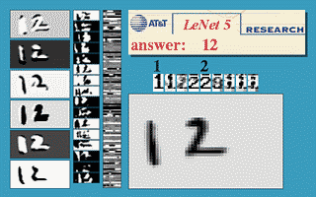
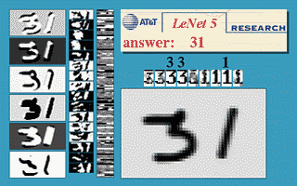
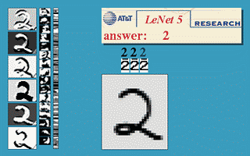
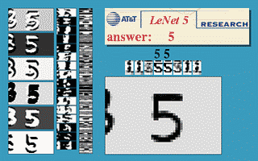
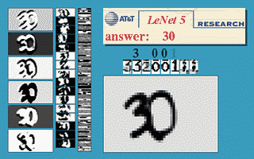
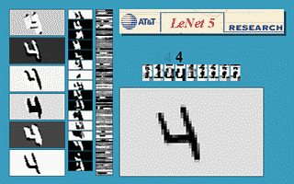
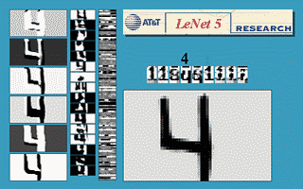
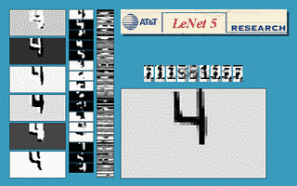
Notes:
One of the successes in the 80’s was using convolution networks to analyze handwritten characters.
These systems were used to scan and decode mailing addresses on envelopes, and the money amounts in personal checks.
But those early systems mostly failed on more complex tasks.
11

Slide 12
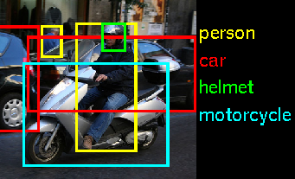
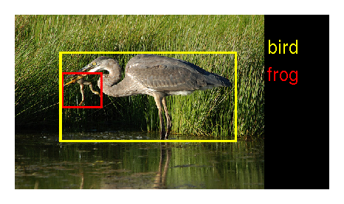
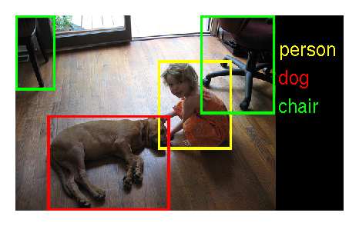
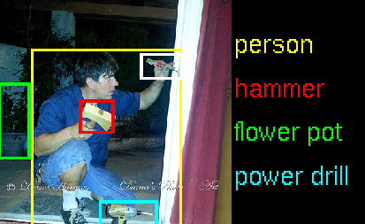
ImageNet Recognition Challenge
1.2M training images, 1000 object categories
person
car
helmet
motorcycle
bird
frog
person
hammer
flower pot
power drill
person
dog
chair
Notes:
The modern deep learning systems can handle much more challenging vision tasks than recognizing handwritten characters.
Imagenet is a research competition where computer vision and machine learning systems first get to see over a million images of 1000 different types of objects.
Then they are given new images that they haven’t seen before, and they need to recognize and locate the objects in those images.
12

Slide 13
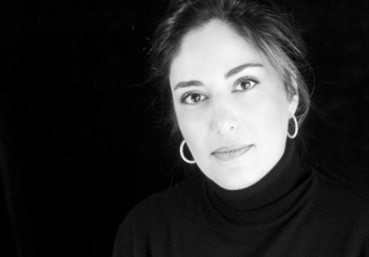
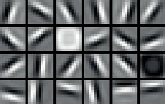
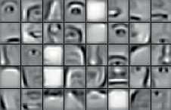
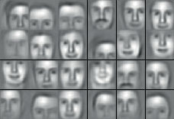
Deep Neural Networks
Learning by abstraction
(Weights)
Image
“Sara”
Notes:
This diagram shows how a deep convolutional network works.
On the left, the image is passed to the network.
<click> The first convolution layer applies various filters on the image, producing new “images”, where a high value indicates a presence of a low-level features such as an edge, or a disk shape.
<click> The deeper layers are a bit more difficult to visualize, but we can show what kind of features they respond to.
The next layer could be sensitive to face segments, such as an eye or a nose or an eyebrow,
<click> and a yet deeper layer could be sensitive to types of faces.
The final layers then interpret the presence of different features as probabilities of a particular object being in the image, and gives a high likelihood that this is a picture of a woman called Sara.
13

Slide 14
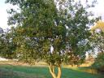
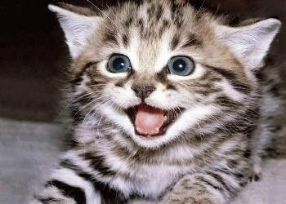
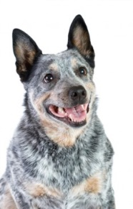
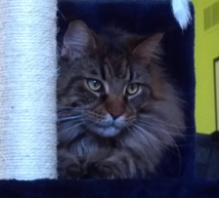
Deep Learning Framework
Forward Propagation
Repeat
“turtle”
Tree
Backward Propagation
Cat
Update the weights to nudge
from “turtle” towards “dog”
Trained Model
Dog
“cat”
Notes:
Here I will illustrate how a deep learning system is trained.
Say that we have a partially trained network, and some training images,
<click> of which we select one.
<click> We pass the image in and analyze it using the network and they weights stored in the connections of the network,
<click> and get a result that is wrong.
<click> As we see that there was an error, we can propagate the errors backward, and modify the weights in the network so that the next time a similar image is shown, the system is more liklely to give a correct answer.
<click – click> And then we repeat this with more training examples.
<click> Eventually, we stop training, freeze the weights,
<click> and can use the system to correctly analyze new images.
14

Slide 15
Vision Summary
Computer Vision is difficult,
but it is getting practical “in the wild”, not just in the lab
NVIDIA accelerates traditional computer vision:
on servers (Tesla, Quadro)
on mobile / embedded devices (Tegra, with the same GPU architecture)
and with the same development tools on both platforms
Deep learning is changing many things, including CV
deep learning is best done on GPUs with CUDA, TK1 included
(though training will still be faster on a 10^2 to 10^4 watt CUDA desktop)

Slide 16
OpenCV
OpenCV is a library of programming functions mainly aimed at real-time computer vision
We may use OpenCV without ROS.
In this section, we will discuss about the usage of OpenCV
Notes:
16

Slide 17
Install additional package in Turtlebot Pi
In a new terminal
>> cd innokai_workshop_ws/src
>> git clone https://github.com/ros-drivers/usb_cam.git
>> cd ~/innokai_workshop_ws
>> catkin_make
Notes:
17

Slide 18
Testing Camera
Recall connect PC and turtlebot from the DAY 1
In your Laptop
>> roscore
In your Turtlebot
>> rosrun usb_cam usb_cam_node _pixel_format:=yuyv _video_device:=/dev/video0
Notes:
18

Slide 19
In Laptop
>> rosto pic list
>> rqt_image_view
Notes:
19

Slide 20
cv2 and sensor_msgs/Image
The image sent by Turtlebot is sensor_msgs/Image.
However, OpenCv can only process cv2 image.
Thus Cvbridge come in
To install
>> sudo apt install ros-kinetic-vision-opencv
Notes:
20

Slide 21
Introduction to OpenCV
Resizing images
>> resized = cv2.resize(image, (200, 200))
Resizing in ratio
Using imutils
In a new terminal to install imutils
>> pip install imutils --user
Notes:
21

Slide 22
Rotating an image
>> rotated = imutils.rotate(image, -45)
Rotate without clipping
>> rotated = imutils.rotate_bound(image, 45)
Smoothing an image
>> blurred = cv2.GaussianBlur(image, (11, 11), 0)
Notes:
22

Slide 23
Drawing on an image
rectangle
cv2.rectangle(output, (320, 60), (420, 160), (0, 0, 255), 2)
circle
cv2.circle(output, (300, 150), 20, (255, 0, 0), -1)
line
cv2.line(output, (60, 20), (400, 200), (0, 0, 255), 5)
Notes:
23

Slide 24
Put Text
cv2.putText(output, "OpenCV + Jurassic Park!!!", (10, 25),cv2.FONT_HERSHEY_SIMPLEX, 0.7, (0, 255, 0), 2)
Notes:
24

Slide 25
Detecting Object
Important, we CANNOT assume computer something like human
Many layers need to calculated to achieve a purpose
You may code yourself or just search online for similar
Notes:
25

Slide 26
OpenCV and ROS
The usage of OpenCV will be image processing
It serve as as a sensor
Notes:
26

Slide 27
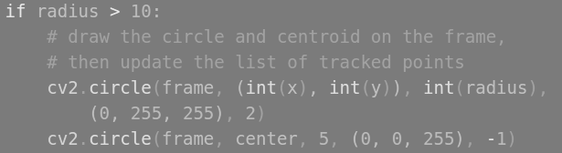
Detect Green ball
Example, we control the robot to follow a green ball using the code found online
Just look for the final output, usually, it’s show in cv2.imshow, or cv2.rectangle
Notes:
27

Slide 28
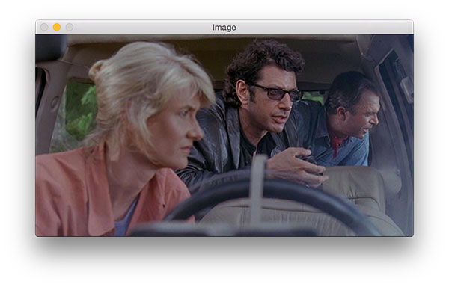
0 (y)
0 (x)
Notes:
28

Slide 29
Task
By using the previously learn code, Twist
Always make sure facing to a green object
Notes:
29

Slide 30
Task
Say, we need to follow the ball, we make sure the ball is always at center of x axis
Thus, half of total value of x axis will be the center. total value will be the width of stream
Notes:
30

Slide 31
End of DAY 3
See you NEXT TIME

